Slide 1

DEPARTMENT OF ELECTRICAL AND ELECTRONICS ENGINEERING
ARTIFICIAL INTELLIGENCE BASED GEN NEXT SMART VEHICLE SAFETY AND MONITORING SYSTEM FOR SUSTAINABLE TRANSPORTATION
EEB1233 - DESIGN THINKING
BATCH NO: 06
END SEMESTER REVIEW
PRESENTED BY:
1. MOUNITHA M [927624BEE064]
2. PIRAGATHESHWARAN M [927624BEE072]
3. RAGAVARSHINI M [927624BEE080]
4. SRIDHANYA M [927624BEE096]
GUIDED BY:
Dr S.SATHISH KUMAR M E.,Ph.D.,
ASSOCIATE PROFESSOR
DEPARTMENT OF EEE

Slide 2
OVERVIEW OF THE PRESENTATION
Abstract
Introduction
Literature Review
Existing System
Block Diagram of Existing System
Problem Statement
Objective
Block diagram
Modes of Operation
Working
Proposed System
Circuit Diagram of the project
Result and Discussion
3D Design
Experimental Implementation
Innovation and Uniqueness
Existing and proposed system
Impact and benefits of the project
Conclusion
Future Scope
References

Slide 3
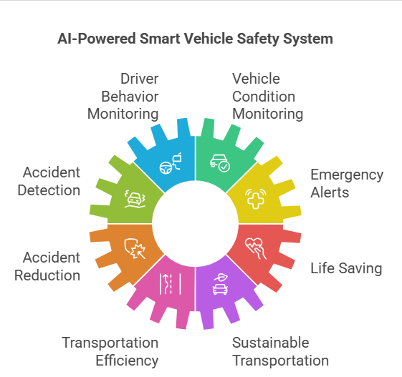
ABSTRACT
Smart vehicle safety system using sensors and a camera to monitor driver and vehicle conditions.
It detects drowsiness, over-speeding, alcohol usage, and accidents in real time.
The system sends alerts to emergency contacts, improving safety and reducing accidents.

Slide 4
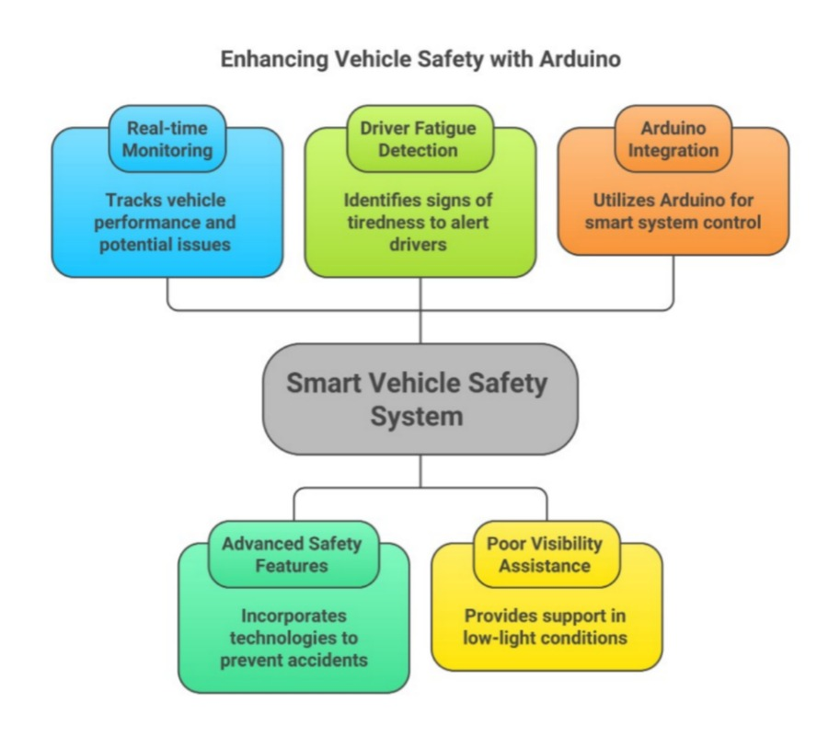
INTRODUCTION
In today’s world, vehicle safety has become a major concern due to the increasing number of road accidents and system failures.
Many traditional vehicles lack real-time monitoring and advanced safety features, which can lead to serious problems such as engine overheating, gas leakage, and electrical faults.
Driver fatigue and poor visibility also contribute to accidents, making it necessary to develop smarter safety solutions.
To address these challenges, this project proposes a Smart Vehicle Safety System using Arduino.

Slide 5
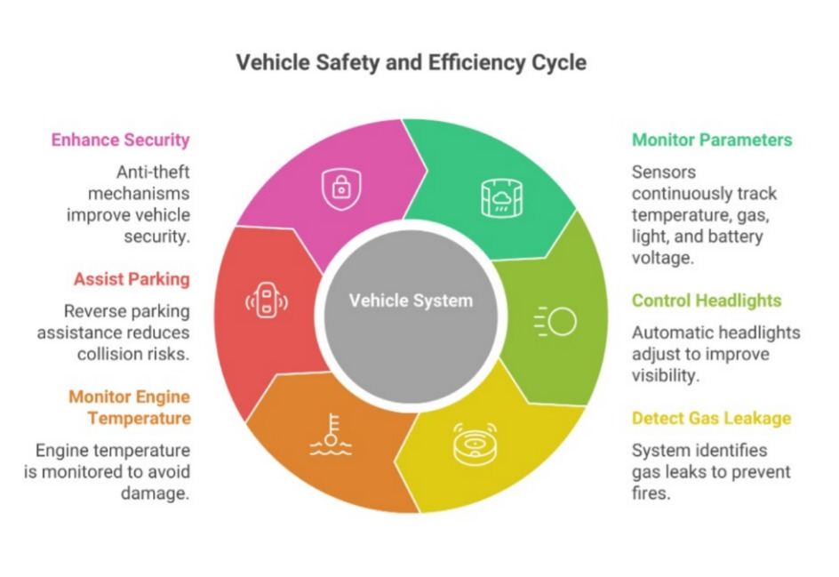
INTRODUCTION
The system integrates multiple sensors to continuously monitor important parameters like temperature, gas levels, light intensity, and battery voltage.
It also includes features such as automatic headlight control to improve visibility, gas leakage detection to prevent fire hazards, and engine temperature monitoring to avoid mechanical damage.
Additionally, reverse parking assistance helps in reducing collision risks, while anti-theft mechanisms enhance vehicle security.

Slide 6
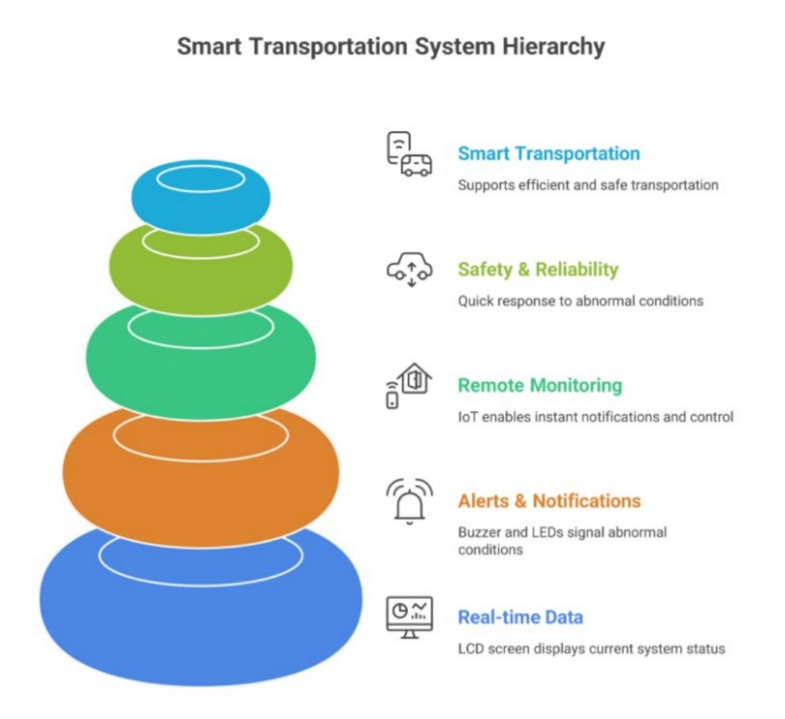
INTRODUCTION
The system provides alerts through a buzzer and LED indicators and displays real-time data on an LCD screen.
IoT technology is used to enable remote monitoring and instant notifications.
The system is designed to respond quickly to abnormal conditions, thereby improving overall vehicle safety and reliability.
Hence, this project supports the concept of smart, efficient, and safe transportation.

Slide 7
LITERATURE REVIEW
S.NO | Title of paper | Authors | Year | Description | Problem identified
S.No | Title of Paper | Authors | Year | Description | Problem Identified
1 | IoT-Based Smart Vehicle Monitoring System | Sharma.P | 2023 | Uses IoT to monitor vehicle condition and send real-time updates. | No proper real-time communication between vehicle and user.
2 | Vehicle Safety Monitoring Using IoT and Sensors | Das.p | 2023 | The system uses loT and sensors to continuously monitor vehicle condition and send real-time updates to users through cloud platforms. | Absence of real-time monitoring leads to delayed detection of issues and increases accident risk.
3 | Smart Driver Assistance System Using Al | Mehta.R | 2024 | This study proposes an Al-based system that monitors driver behavior and provides real-time alerts for unsafe driving conditions like over-speeding and distraction. | Existing systems do not provide intelligent real-time decision-making for accident prevention.

Slide 8
LITERATURE REVIEW
S.NO | Title of paper | Authors | Year | Description | Problem identified
S.No | Title of Paper | Authors | Year | Description | Problem Identified
4 | Smart Driver Assistance System Using Al | Meta.R | 2024 | This study proposes an Al-based system that monitors driver behavior and provides real-time alerts for unsafe driving conditions like over-speeding and distraction. | Existing systems do not provide intelligent real-time decision-making for accident prevention.
5 | Al-Based Smart Transportation Safety System | Chen.L | 2024 | This paper presents an Al-driven system that integrates monitoring, prediction, and alert mechanisms to improve vehicle safety and efficiency. | Lack of Al integration in traditional systems reduces safety and system performance.
6 | AI Based Driver Drowsiness Detection System | Kumar.R | 2024 | AI-based system using camera to detect driver drowsiness in real-time. | Existing systems cannot accurately detect driver fatigue, leading to accidents.

Slide 9
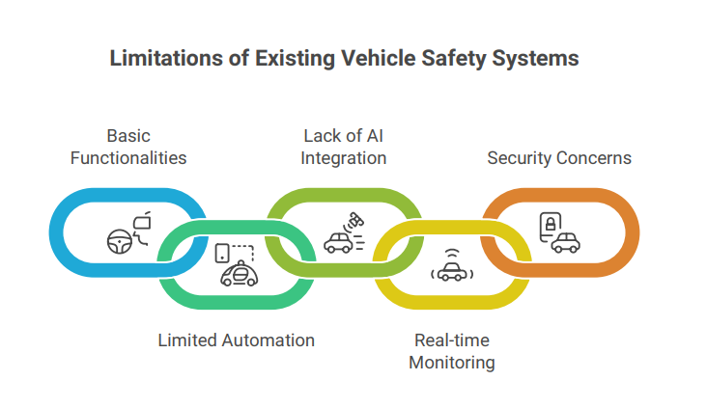
EXISTING SYSTEM
Existing vehicle safety and monitoring systems mainly focus on basic functionalities such as GPS tracking, speed monitoring, and manual emergency alerts.
Traditional systems have limited automation and depend heavily on human intervention for detecting accidents and unsafe driving conditions.
Most existing systems do not use advanced Artificial Intelligence techniques for driver behavior analysis or predictive safety measures.
In many cases, the monitoring process is not real-time and lacks proper IoT connectivity for remote access and cloud-based data analysis.
Additionally, conventional systems provide limited security features and are less effective in preventing accidents and ensuring efficient vehicle management

Slide 10
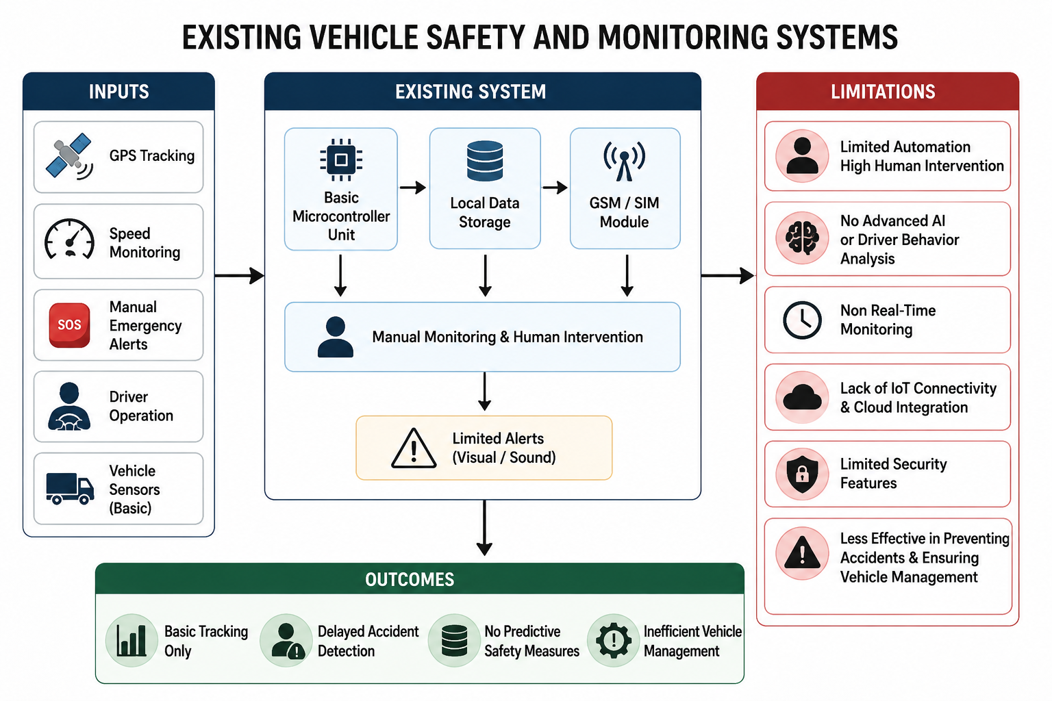
BLOCK DIAGRAM OF EXISTING SYSTEM

Slide 11
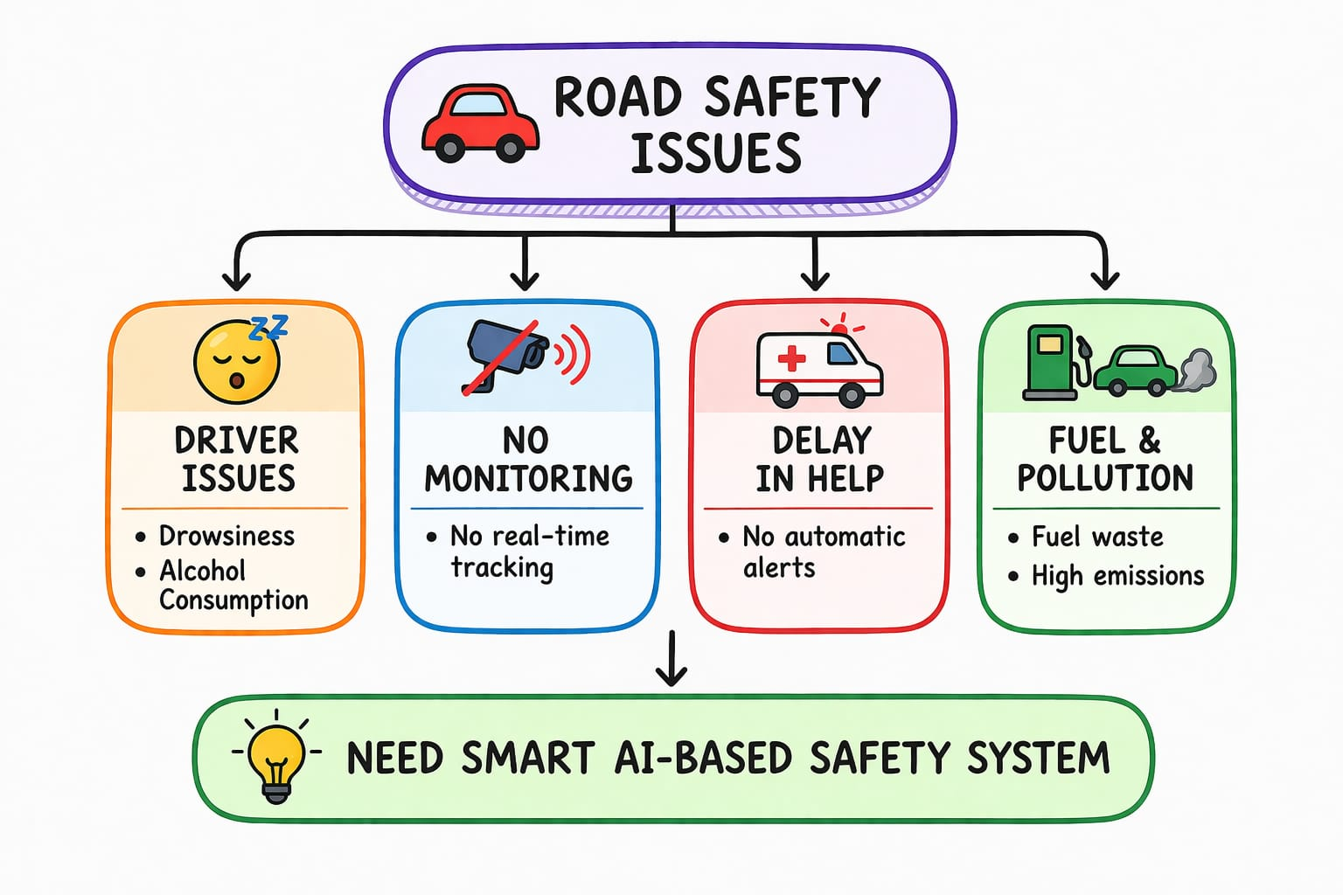
PROBLEM STATEMENT
Road accidents are increasing due to unsafe driving, drowsiness, and alcohol consumption.
Lack of continuous monitoring and delay in emergency alerts increase risks.
Fuel wastage and pollution rise due to inefficient driving, and existing systems lack real-time response.
Hence, an intelligent and automated safety system is needed.

Slide 12
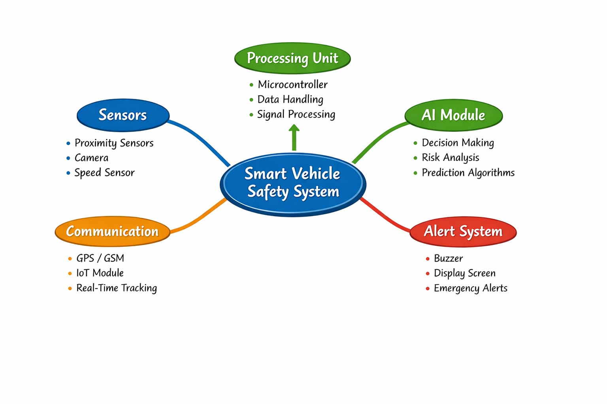
OBJECTIVE OF THE PROJECT

Slide 13
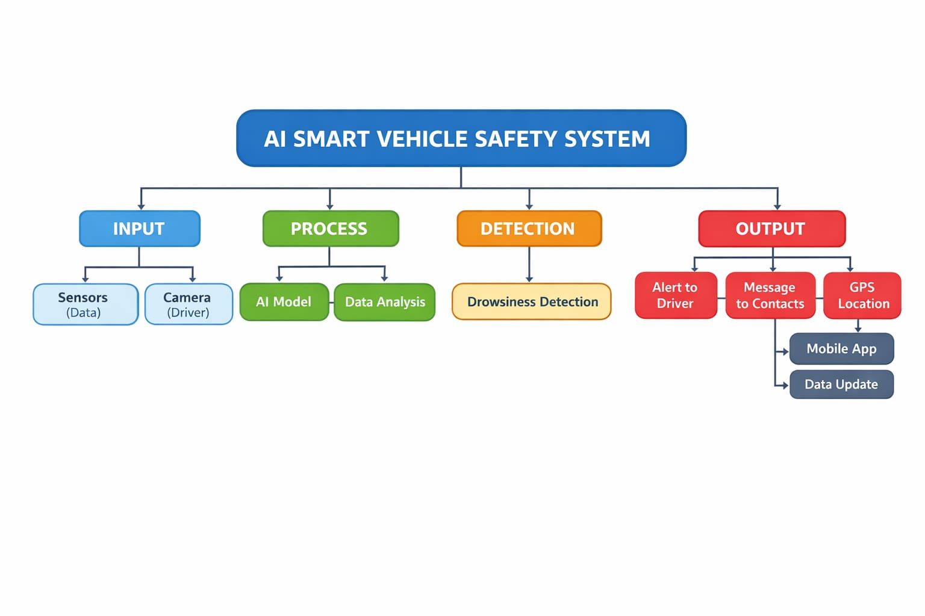
BLOCK DIAGRAM
Input: Sensors and camera collect vehicle data and monitor the driver.
Process: AI model analyzes the data and checks driver behavior.
Detection: System detects driver drowsiness.
Output: Alerts the driver, sends messages to contacts, and shares GPS location.
Mobile App: Displays data and updates vehicle status.

Slide 14
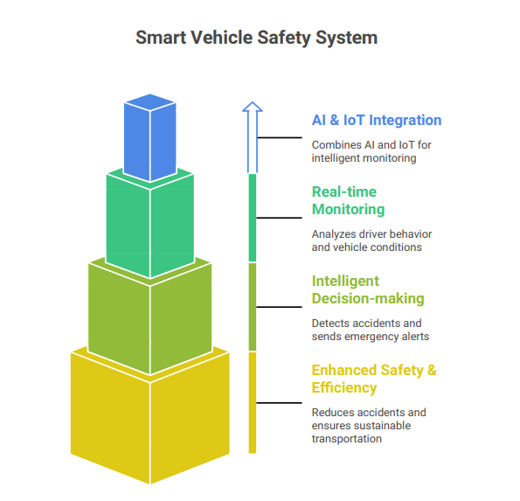
MODES OF OPERATION
The proposed system operates in multiple modes to ensure vehicle safety, monitoring, and efficient performance.
In Monitoring Mode, the system continuously collects real-time data from various sensors installed in the vehicle.
Safety Detection Mode identifies accidents, obstacles, over-speeding, and other unsafe conditions to prevent potential hazards.
AI Analysis Mode uses artificial intelligence algorithms to monitor driver behavior such as drowsiness, distraction, and rash driving.

Slide 15
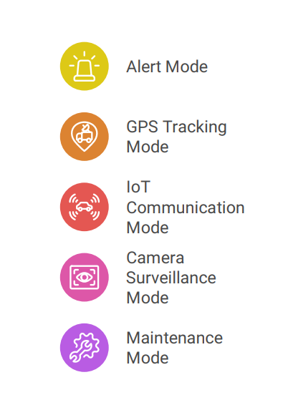
MODES OF OPERATION
In Alert Mode, emergency notifications and warning messages are sent automatically during critical situations.
GPS Tracking Mode enables live vehicle location tracking for security and navigation purposes.
IoT Communication Mode allows sensor data to be transmitted to cloud platforms or mobile applications for remote monitoring.
Camera Surveillance Mode captures real-time images and videos for enhanced security, while Maintenance Mode monitors engine condition, fuel level, and overall vehicle performance for predictive maintenance and improved reliability.

Slide 16
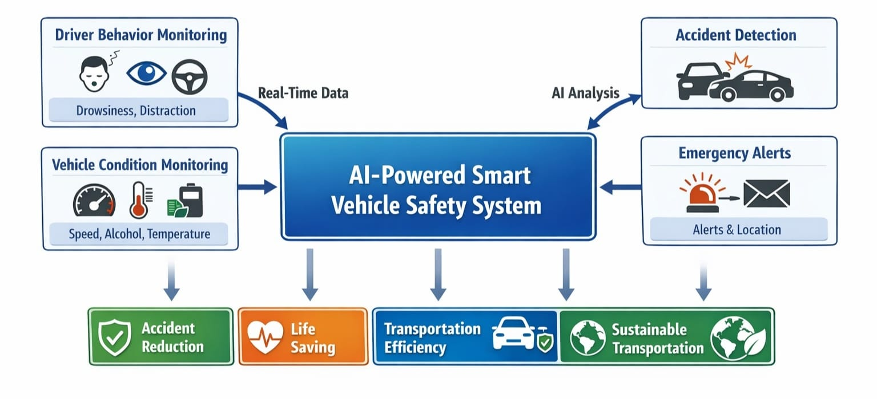
WORKING
System starts when the vehicle is turned ON, and sensors collect data like speed, alcohol level, and temperature while the camera monitors the driver.
AI processes the data to detect drowsiness, over-speeding, and abnormal conditions, and gives alerts if needed.
In case of an accident, the system activates emergency alerts and sends messages to users and contacts, with data shown in a mobile application.

Slide 17
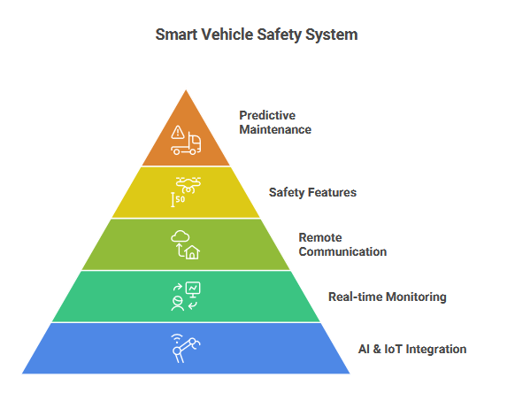
PROPOSED SYSTEM
The proposed system is an Artificial Intelligence based smart vehicle safety and monitoring system designed to improve road safety, vehicle security, and transportation efficiency.
The system integrates AI, IoT, GPS, sensors, and camera modules to provide real-time monitoring and intelligent decision-making. It continuously analyzes driver behavior, detects accidents, monitors vehicle conditions, and sends emergency alerts automatically during critical situations.
The IoT-based communication enables remote monitoring through cloud platforms or mobile applications, while GPS tracking provides accurate vehicle location information.
The system also includes obstacle detection, camera surveillance, and predictive maintenance features to reduce accidents, minimize human errors, and ensure safe and sustainable transportation.

Slide 18
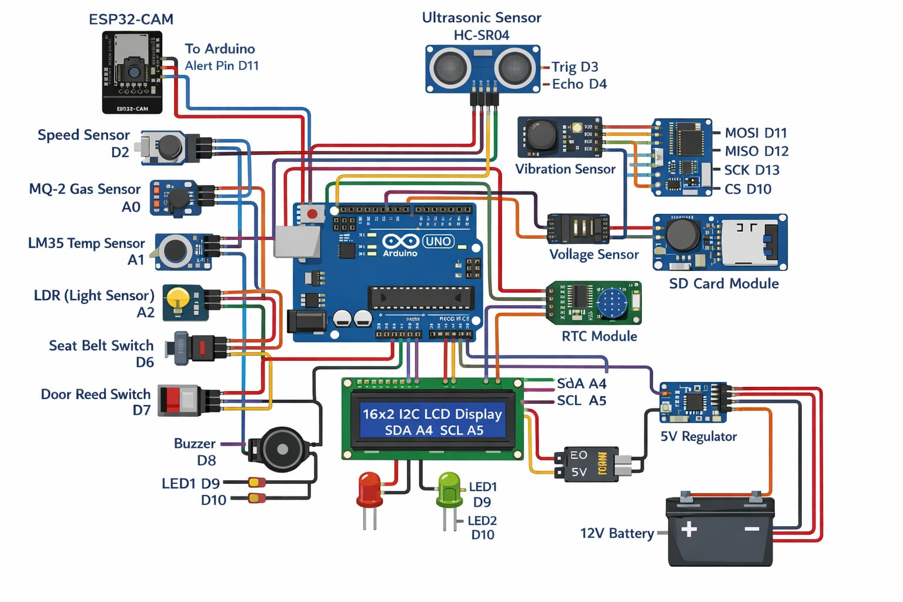
CIRCUIT DIAGRAM OF THE PROJECT
An Arduino Uno–based multi-sensor system monitors environmental and system conditions using ultrasonic, gas, temperature, light, vibration, and voltage sensors.
It includes input switches (seat belt and door) and output devices like an LCD, buzzer, and LEDs for alerts.
Additional modules such as an SD card, RTC, and ESP32-CAM enable data logging, time tracking, and communication.
Powered by a 12V battery with a 5V regulator, it is ideal for smart safety applications.

Slide 19
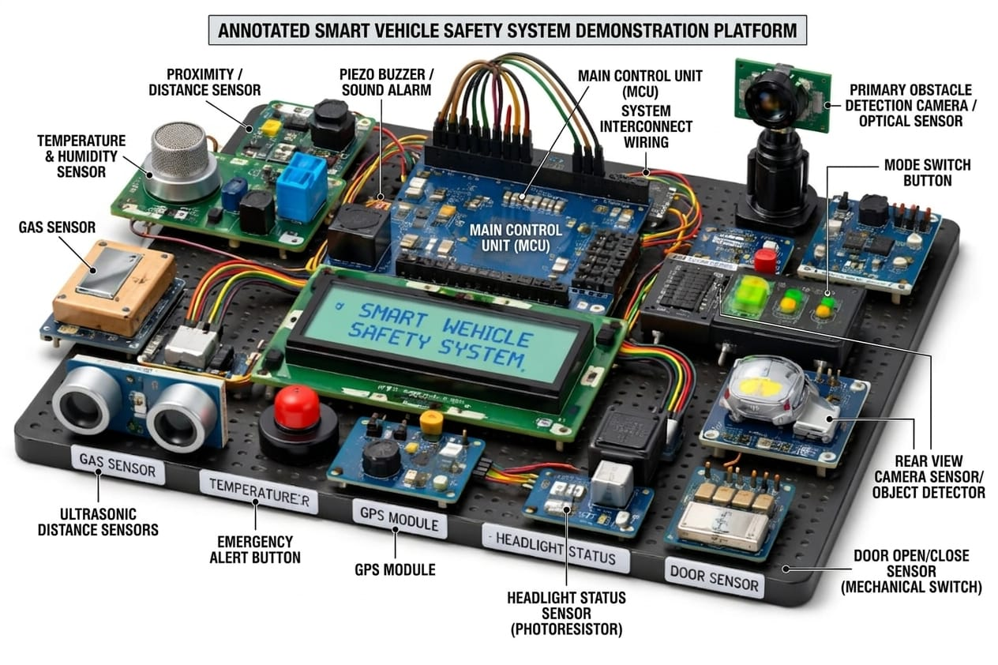
CIRCUIT DIAGRAM OF THE PROJECT
The image shows a Smart Vehicle Safety System with multiple sensors connected to a main control unit (MCU).
Sensors like ultrasonic, gas, temperature, and camera detect obstacles and conditions.
The system provides alerts using a buzzer and display, improving vehicle safety and monitoring.

Slide 20
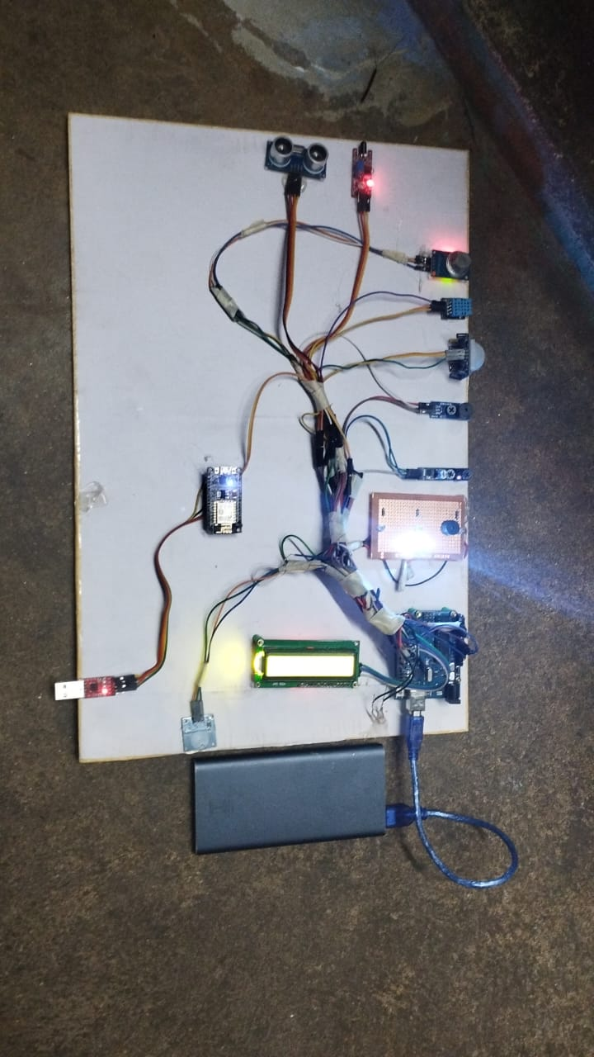
RESULT AND DISCUSSION

Slide 21
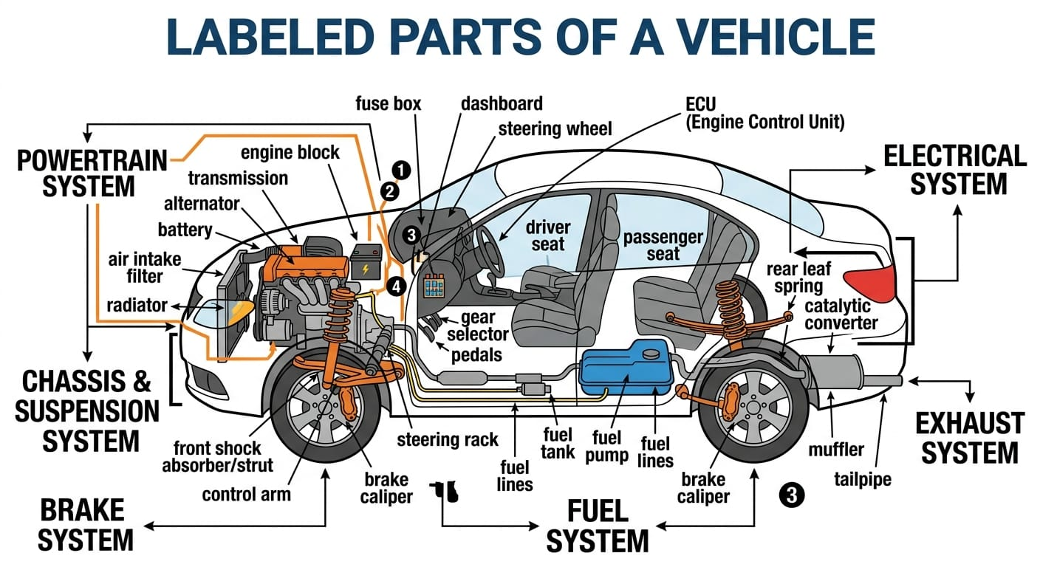
3D DESIGN

Slide 22
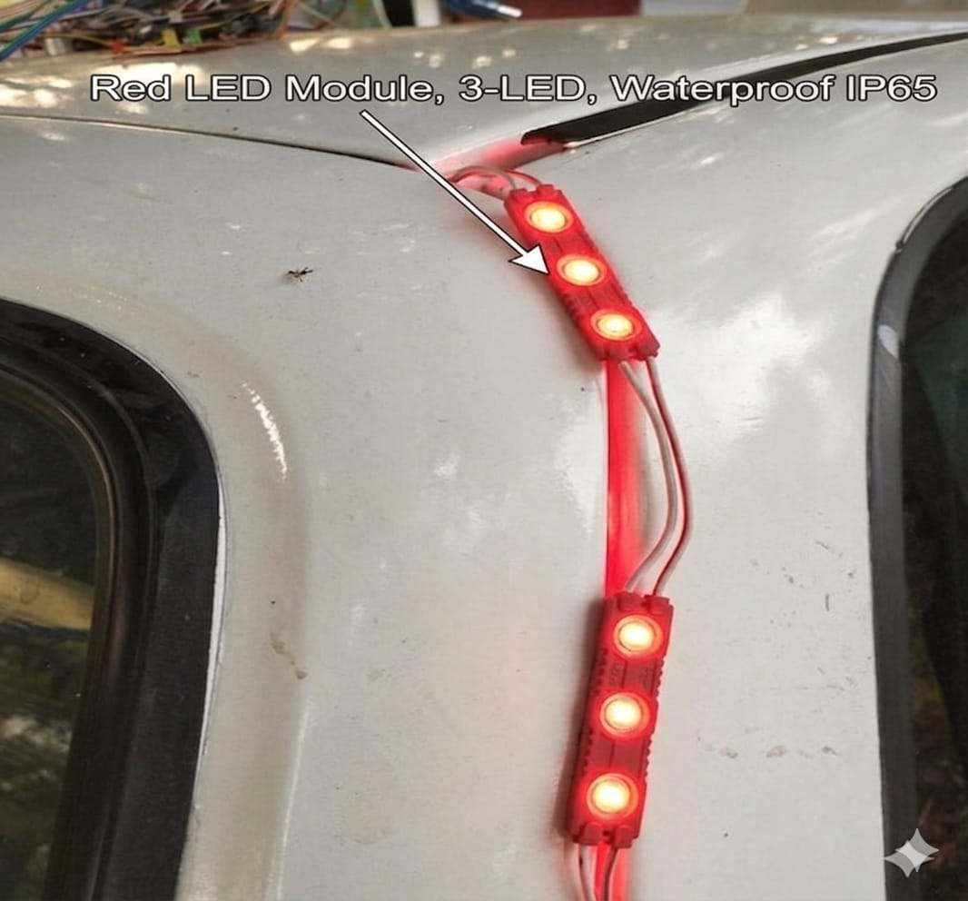
EXPERIMENTAL IMPLEMENTATION OF THE PROJECT
(HALL SENSOR)
When the speed exceeds the predefined limit, the Hall sensor generates pulses based on the rotation of the wheel, which are used by the controller (such as Arduino) to calculate the speed.
The system continuously compares the measured speed with the set limit. If the speed crosses this limit, the controller sends a signal to the LED module, causing it to glow as a warning indication.
This light alerts the user or driver that the speed is too high. When the speed comes back within the safe limit, the signal stops and the LED turns OFF. Thus, the LED acts as a visual alert system for over-speed conditions.

Slide 23
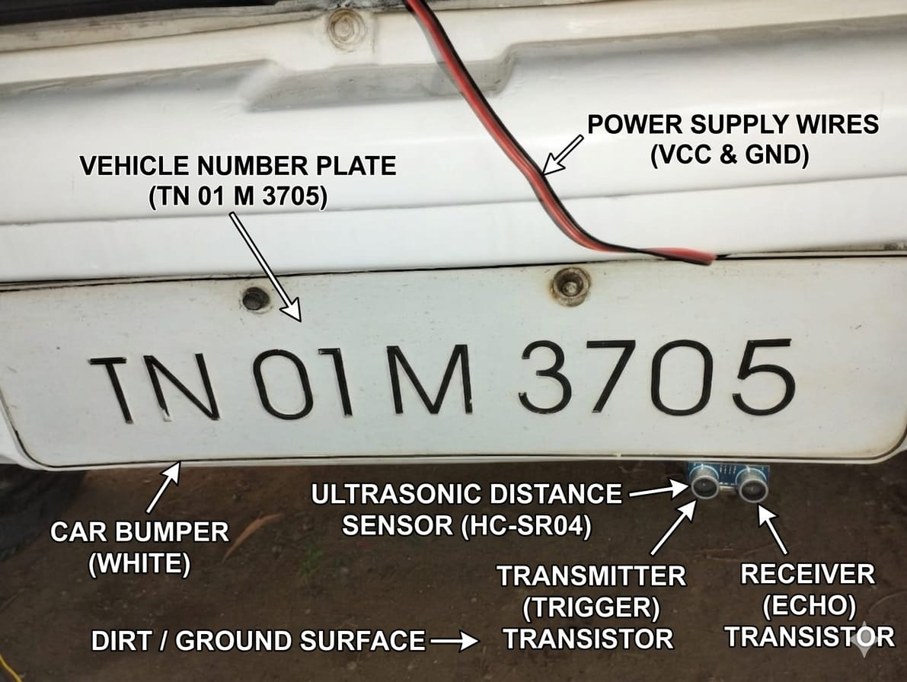
EXPERIMENTAL IMPLEMENTATION OF THE PROJECT
(ULTRASONIC DISTANCE SENSOR)
The image shows an ultrasonic distance sensor (HC-SR04) installed on a car bumper near the number plate to measure distance from obstacles or the ground.
It includes labeled components such as power supply wires (VCC & GND), and the sensor’s transmitter (trigger) and receiver (echo).
This setup is used in vehicle safety systems for parking assistance and obstacle detection.

Slide 24
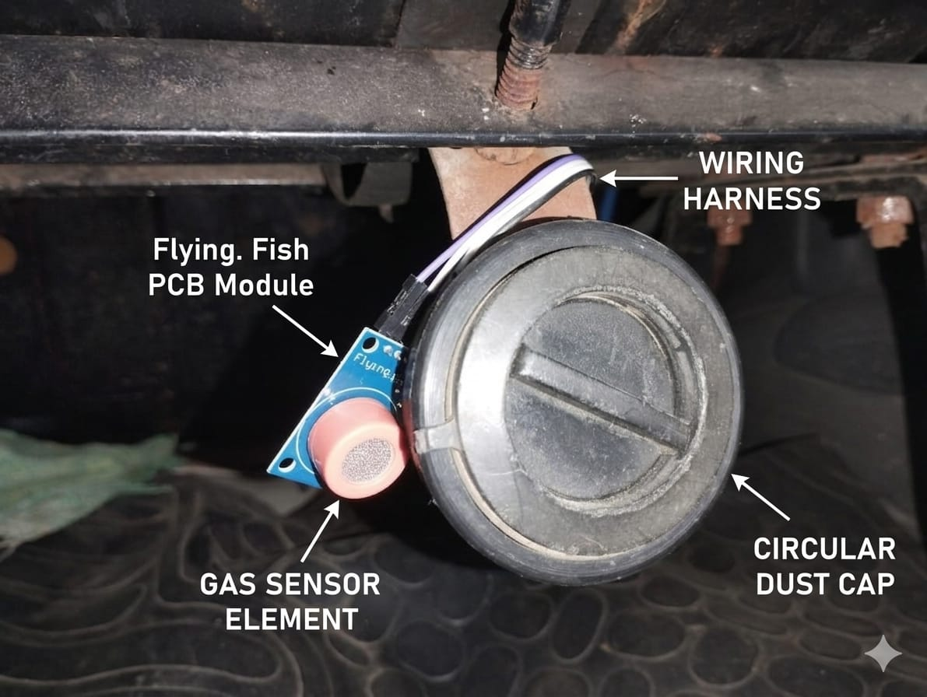
EXPERIMENTAL IMPLEMENTATION OF THE PROJECT
(GAS SENSOR)
The image shows a gas sensor module (Flying Fish PCB) installed underneath a vehicle to detect harmful gases or leaks.
It includes components such as the gas sensor element, wiring harness for power and signal transmission, and nearby structural parts like the dust cap.
This setup is used in vehicle safety systems to monitor gas presence and alert users to potential hazards.

Slide 25
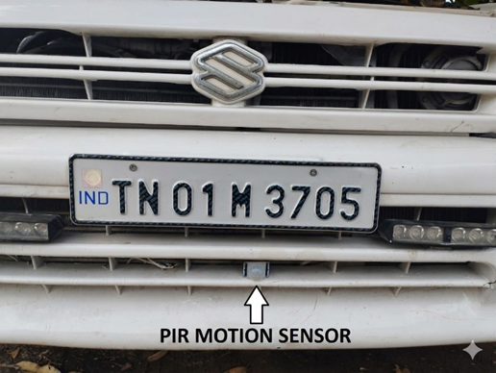
EXPERIMENTAL IMPLEMENTATION OF THE PROJECT
(PIP SENSOR)
A PIR (Passive Infrared) motion sensor is an electronic device used to detect movement by sensing changes in infrared radiation, which is naturally emitted by objects such as humans and animals.
It is called “passive” because it does not emit any energy of its own but instead detects heat differences in its surroundings.
When a warm object moves within its detection range, the sensor identifies the change in infrared levels and generates a signal.

Slide 26
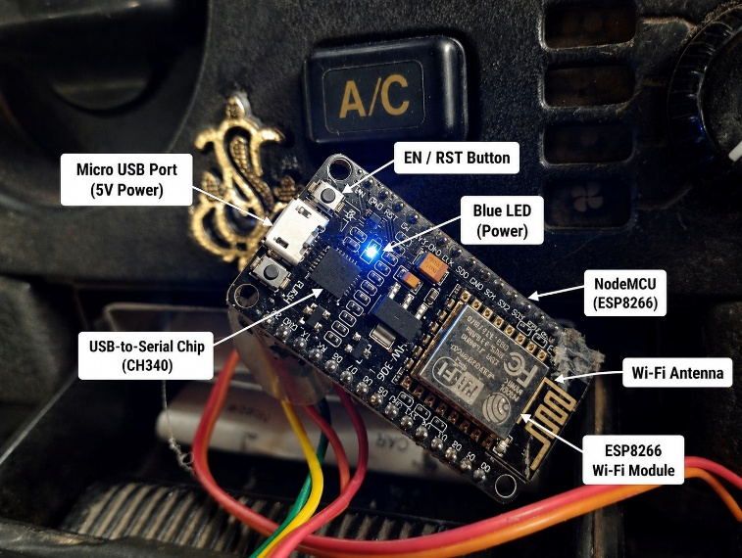
EXPERIMENTAL IMPLEMENTATION OF THE PROJECT
(Arduino Based Embedded System Hardware Setup)
A Node MCU (ESP8266) is a low-cost, open-source microcontroller development board .
That features built-in Wi-Fi capability, allowing it to connect to the internet and communicate with other devices.
It is based on the ESP8266 Wi-Fi module and is widely used in IoT (Internet of Things) applications for tasks such as data monitoring, remote control, and automation.

Slide 27
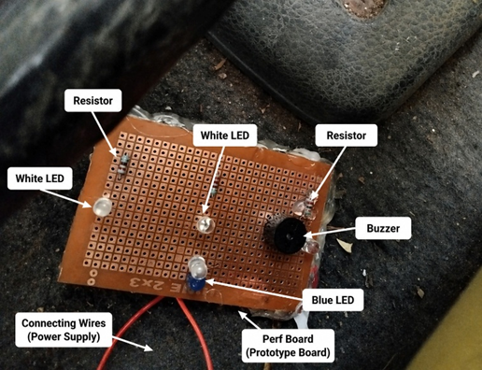
EXPERIMENTAL IMPLEMENTATION OF THE PROJECT
(Prototype Alert Module)
An alert and indication circuit on a perf board is a simple electronic setup used to provide visual and audible signals to indicate system status or events.
It consists of components like LEDs (for visual indication), a buzzer (for sound alerts), resistors (to control current), and connecting wires mounted on a prototype board.
This type of circuit is commonly used in embedded systems to alert users about conditions such as warnings, errors, or system activation.

Slide 28
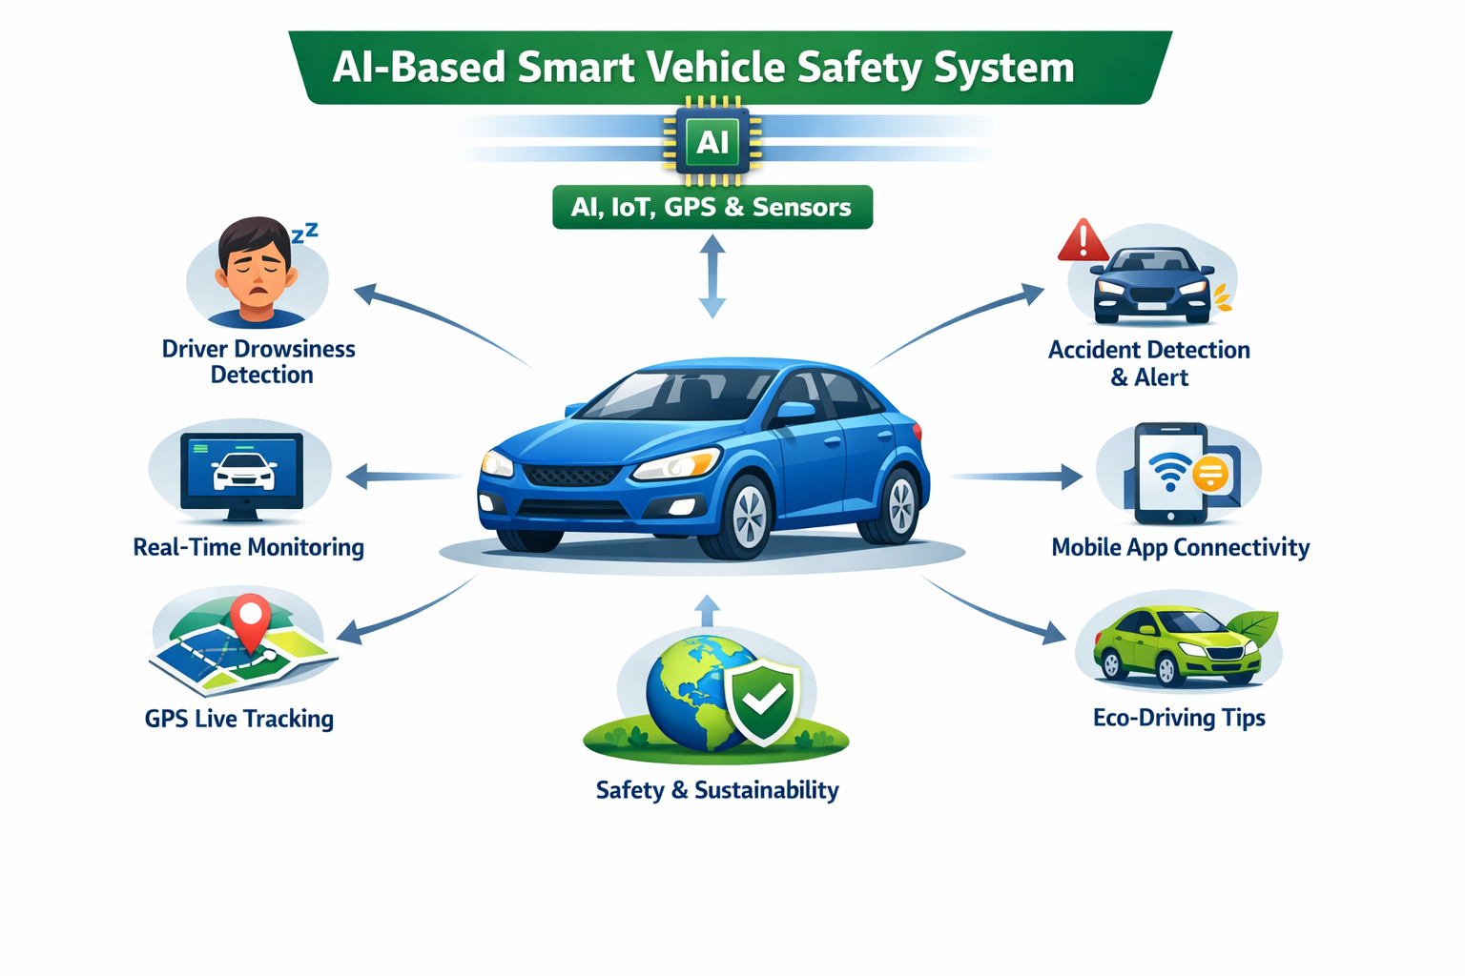
INNOVATION AND UNIQUENESS
AI-based smart vehicle safety system
Combines AI, IoT, GPS, and sensors
Detects driver drowsiness automatically
Real-time monitoring of driver & vehicle
Automatic accident detection and alert
GPS-based live location sharing
Mobile app connectivity (IoT)
Eco-driving for fuel saving
Improves safety and sustainability

Slide 29
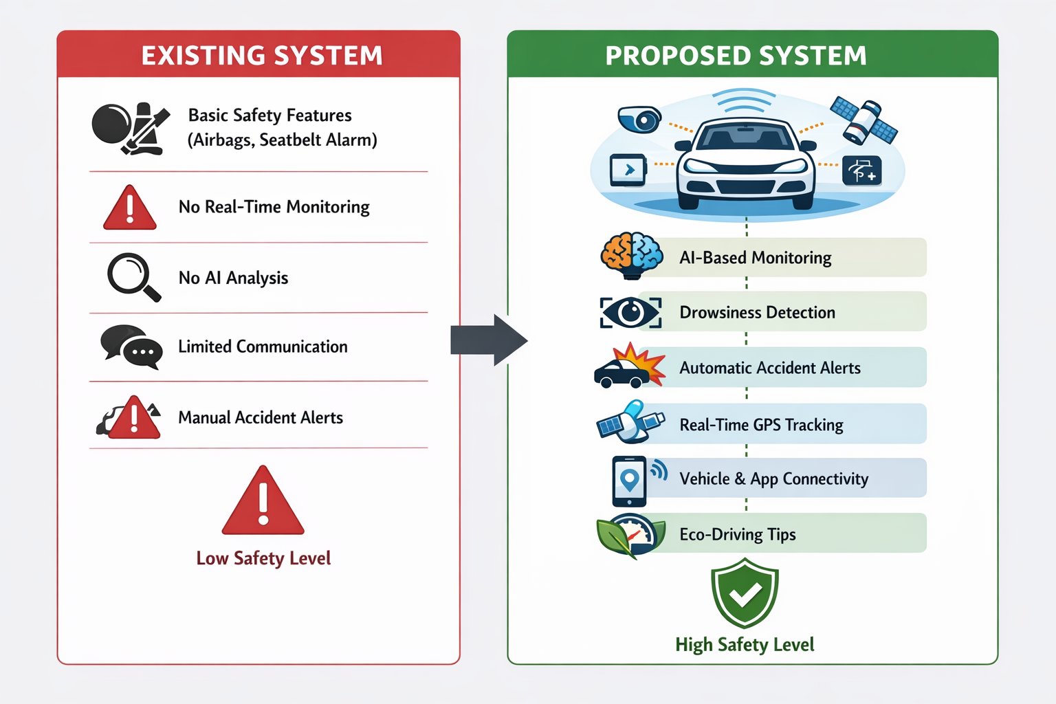
COMPARISON BETWEENB EXISTING AND PROPOSED SYSTEM

Slide 30
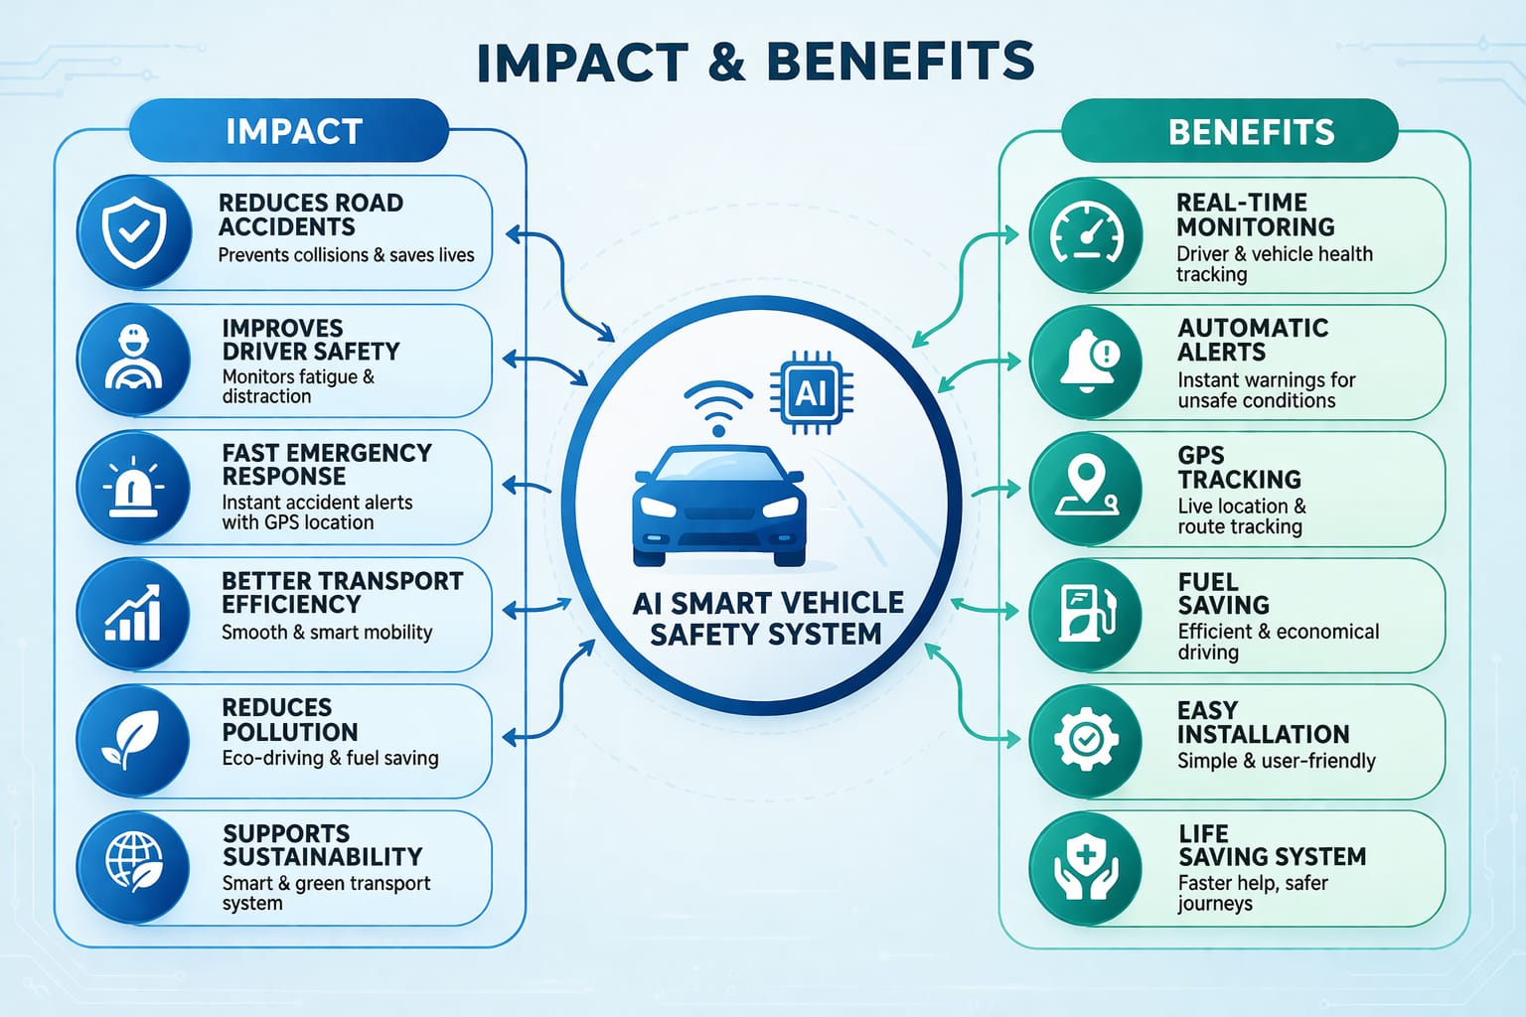
IMPACTS AND BENEFITS OF THE PROJECT

Slide 31
CONCLUSION
Enhances vehicle safety using Artificial Intelligence
Provides real-time monitoring and accident prediction
Reduces road accidents through preventive actions
Includes smart alert and Vehicle Black Box system
Improves transportation efficiency and sustainability
Supports modern smart transportation systems Reliable, intelligent,
and cost-effective solution for future vehicles
Helps in driver behaviour analysis and monitoring
Enables quick emergency response during accidents
Reduces fuel consumption and environmental pollution
Improves overall road safety and traffic management
Useful for personal, commercial, and public transport vehicles
Represents a major advancement in next-generation vehicle technology

Slide 32
FUTURE SCOPE
Integration with IoT and cloud technology. Mobile app for real-time monitoring and alerts. Improved AI algorithms for better accident prediction.
Vehicle-to-Vehicle (V2V) communication support. Smart city and traffic management integration. Autonomous driving feature enhancement.
Better fuel efficiency and emission reduction. GPS-based emergency response system. Driver health monitoring system integration.
Voice assistant and smart navigation support. Real-time traffic and weather analysis. Advanced facial recognition for driver authentication.
Automatic vehicle maintenance prediction. Integration with electric and hybrid vehicles. Cloud-based data storage and analytics. Enhanced cybersecurity for vehicle data protection

Slide 33
REFERENCES
Verma, S. “Smart Accident Detection Using Sensors,” International Journal of Electronics and Communication, 2021.
Reddy, K.,“Accident Detection and Emergency Alert System Using Sensors and GPS,” International Journal of Advanced Engineering Research, 2021.
Khan, S., “IoT-Based Smart Vehicle Safety and Alert System,” Journal of Internet of Things and Smart Systems, 2022.
Singh, A “GPS-Based Vehicle Tracking and Accident Alert System,” Journal of Communication Engineering, 2022.

Slide 34
REFERENCES
Zhang, Y., “Deep Learning-Based Driver Behavior Analysis System,” IEEE Transactions on Intelligent Transportation Systems, 2022.
Sharma, P., “IoT-Based Smart Vehicle Monitoring and Tracking System,” International Journal of Embedded Systems, 2023.
Patel, M. “Real-Time Driver Monitoring System Using Deep Learning,” International Journal of Computer Vision and Applications, 2023.
Lee, J., “Smart Vehicle Monitoring Using AI and Cloud Computing,” Journal of Smart Computing Systems, 2023.
Gupta, V., “AI and IoT Integrated Smart Vehicle Monitoring System,” Journal of Smart Vehicle Technology, 2024.

Slide 35
OUTCOME
The Paper Title “Artificial Intelligence Based Gen Next Smart Vehicle Safety and Monitoring System for Sustainable Transportation "going to submit the IEEE Conference.

Slide 36

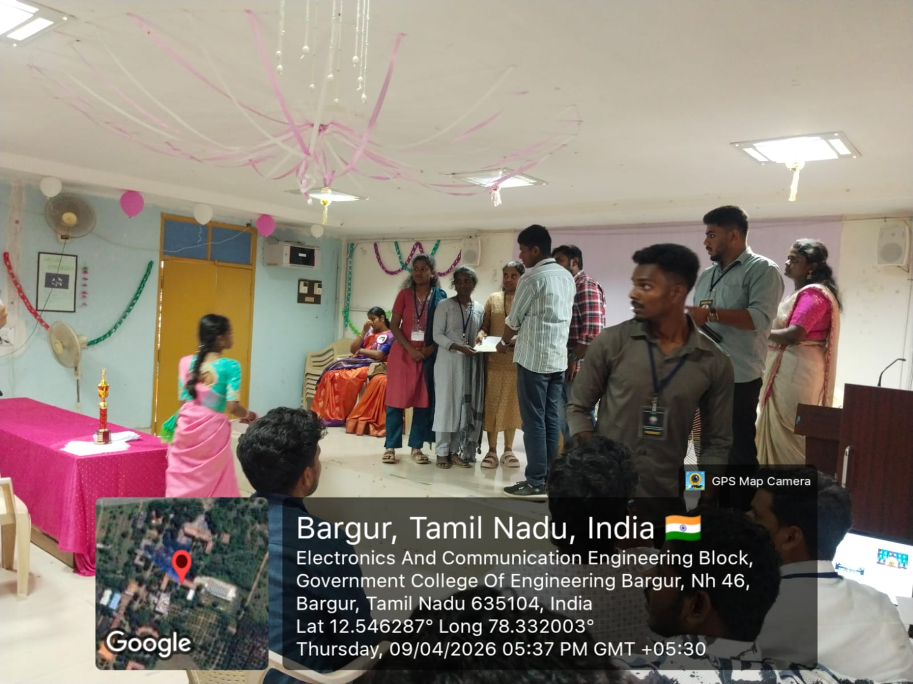
OUTCOME
Won second prize in project presentation in government college of Engineering, Bargur, Krishnagiri.
Won second prize in paper presentation in government college of Engineering, Bargur, Krishnagiri.

Slide 37
THANK YOU

